Slide 1


NEXT GEN EMPLOYABILITY PROGRAM
CREATING A FUTURE-READY WORKFORCE
Student Name :
Andru Manaswini
Student ID :
College Name :
SR University
STU64f9ea0ec45391694099982

Slide 2
CAPSTONE PROJECT SHOWCASE
Project Title
E-Commerce Web Application
Abstract | Problem Statement | Project Overview | Proposed Solution | Technology Used | Modelling & Results | Conclusion | Q&A

Slide 3
Abstract
1
Clothing Store, An E-Commerce web site with Redefining online shopping with a seamless experience,trendy, affordable, and high-quality fashion diverse styles, and doorstep delivery.
2
Front End : For Front End Application i have used React.js and implemented CSS tailwind Framework
3
Back End : For Back End implementation i have used Framework Express.js and Node.js for run time environment
4
Data Base : For Data Base i have used the MongoDB for seamless interaction with User and Client Data

Slide 4


Problem Statement
Limited Access to Fashion: Many customers face challenges accessing a wide variety of trendy, affordable, and sustainable clothing options, especially in remote areas.
Complex Return and Exchange Processes: Customers often struggle with cumbersome return or exchange policies, leading to dissatisfaction and reduced trust.
Inconvenient Shopping Experience: Traditional shopping methods can be time-consuming and lack the personalized experience that online platforms can provide.
Poor Product Representation: Customers frequently face difficulties in assessing the quality, fit, and appearance of clothing due to insufficient or unclear product images, descriptions, and size guides.

Slide 5

Project Overview
User-Friendly Shopping Experience: A clean and intuitive website design with easy navigation, allowing customers to effortlessly browse, filter, and purchase clothing.
Comprehensive Pages: The site includes essential pages: Home, Collection, About, and Contact, providing customers with all the information they need.
Secure Payment Methods: Multiple payment options, including credit/debit cards, digital wallets, and Cash on Delivery (COD), ensuring convenience and trust.
Responsive and Mobile-Friendly: A fully responsive design, ensuring a seamless shopping experience across all devices (mobile, tablet, desktop)
Latest Fashion Trends: Regularly updated with fresh, trendy collections, offering a variety of clothing options for men, women, and accessories.

Slide 6
Proposed Solution
Intuitive Design and Navigation: Create a visually appealing, easy-to-use layout with clear categories and filters, ensuring users can quickly find and purchase the products they want.
Comprehensive Product Display: Implement high-quality images, detailed product descriptions, and size guides on the Collection page to help users make informed buying decisions.
Seamless Payment Integration: Integrate secure and diverse payment gateways, including Cash on Delivery (COD), credit/debit cards, and digital wallets, to provide a range of options for customer convenience.
Regularly Updated Collections: Maintain a dynamic collection of fashion trends with frequent updates, offering the latest styles and seasonal fashion to keep customers engaged.
Responsive and Mobile-Optimized: Ensure the website is fully responsive across all devices, providing a smooth and consistent experience for users, whether on mobile, tablet, or desktop.
Customer Support and Engagement: Implement an accessible Contact page with a live chat feature, email support, and quick responses to customer inquiries, fostering trust and enhancing customer satisfaction.

Slide 7

Technology used
MongoDB - For Data Base
Express.js - For Back End
React.js - For Front End Web Application
Node.js - For Run Time Environment
Tailwind - For CSS Framework

Slide 8
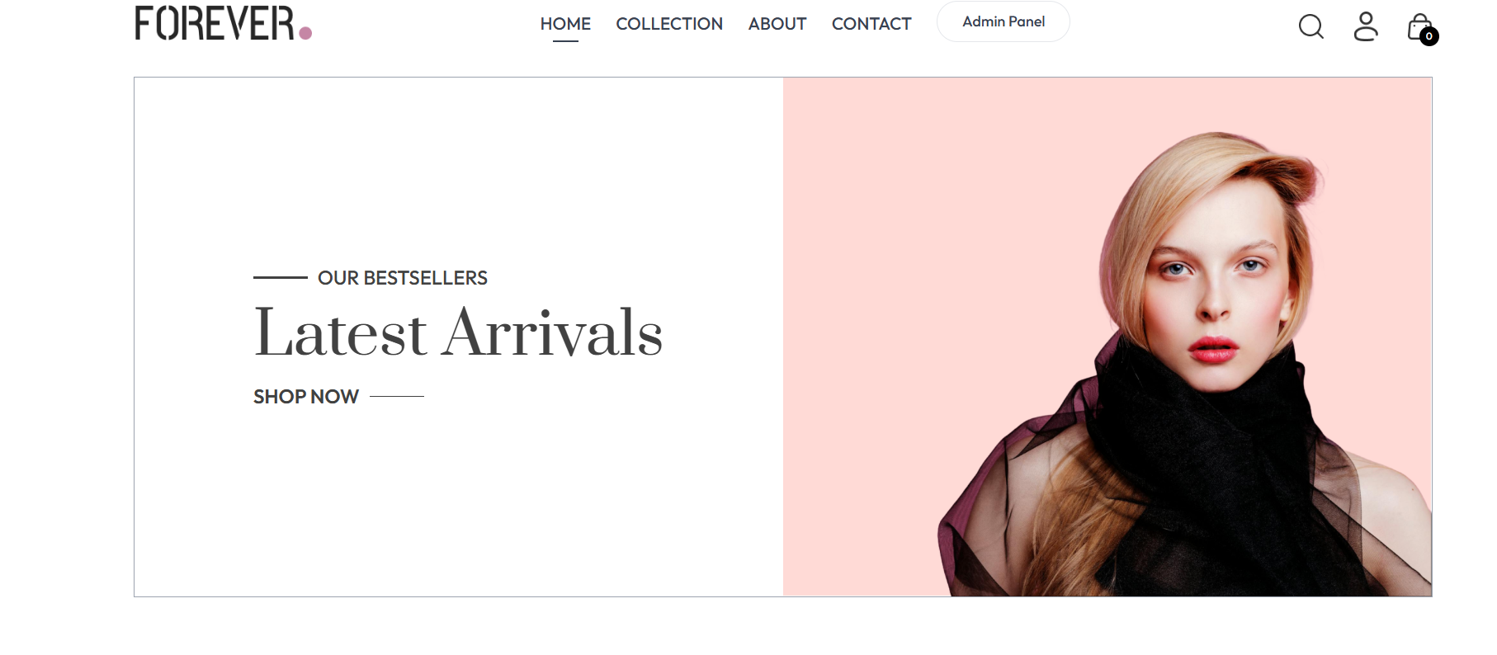
Modelling & Result
Here is my Website Home page
and Brand logo the website
name is Clothing Store
In this Home page the User
can see the Latest Collections
and Best Sellers of my website
and it is very user friendly
interface and easy eccess
application by Clothing Store.

Slide 9
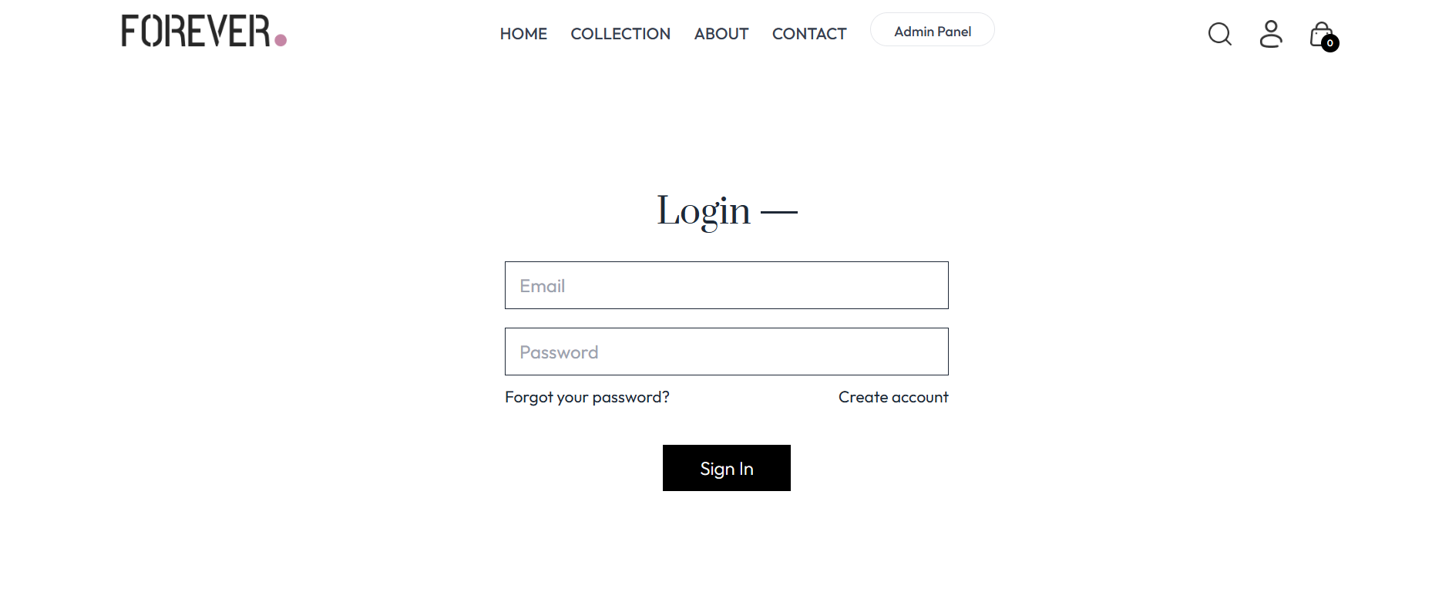
Modelling & Result
This is my result of Collection page
here i in this page the user can see
all Categories fashion collection of my website.
In left side user can find the Filter
option to get easy access of all
the categories fashion collection
and they can filter the type of
product like Topwear and Bottom
wear or Winterwear collections.
And in this page right side user can find the Sort filter option that is price of a product from Low-High or from
High-Low easy to filter the price
of products

Slide 10
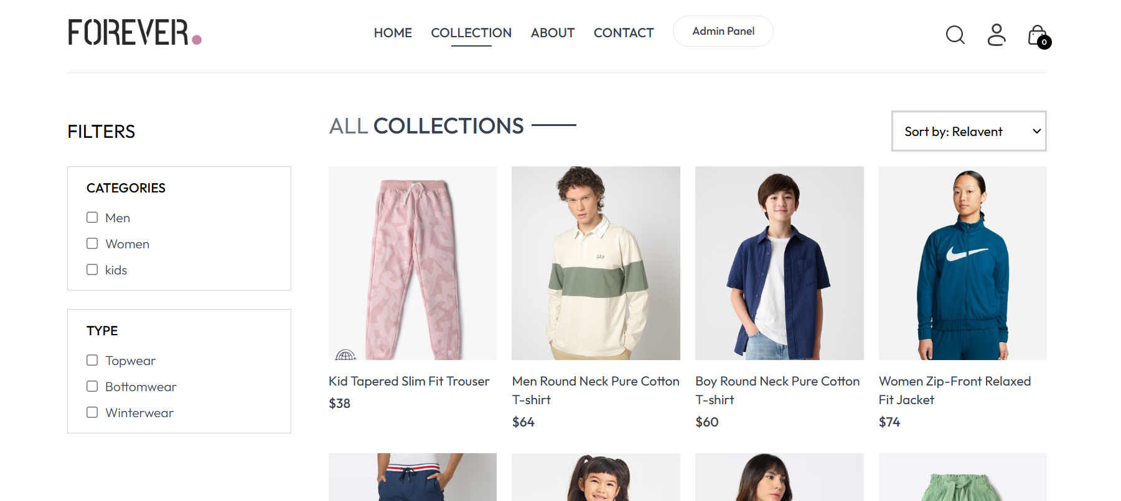
Modelling & Result
In this Product page User can easy access to see the all provided
different side angles of a product
and user can see the price of a product and star rating of a product
if user is impressed with the product
to buy product the user should select the product size first and then
click on the Add to Cart button

Slide 11
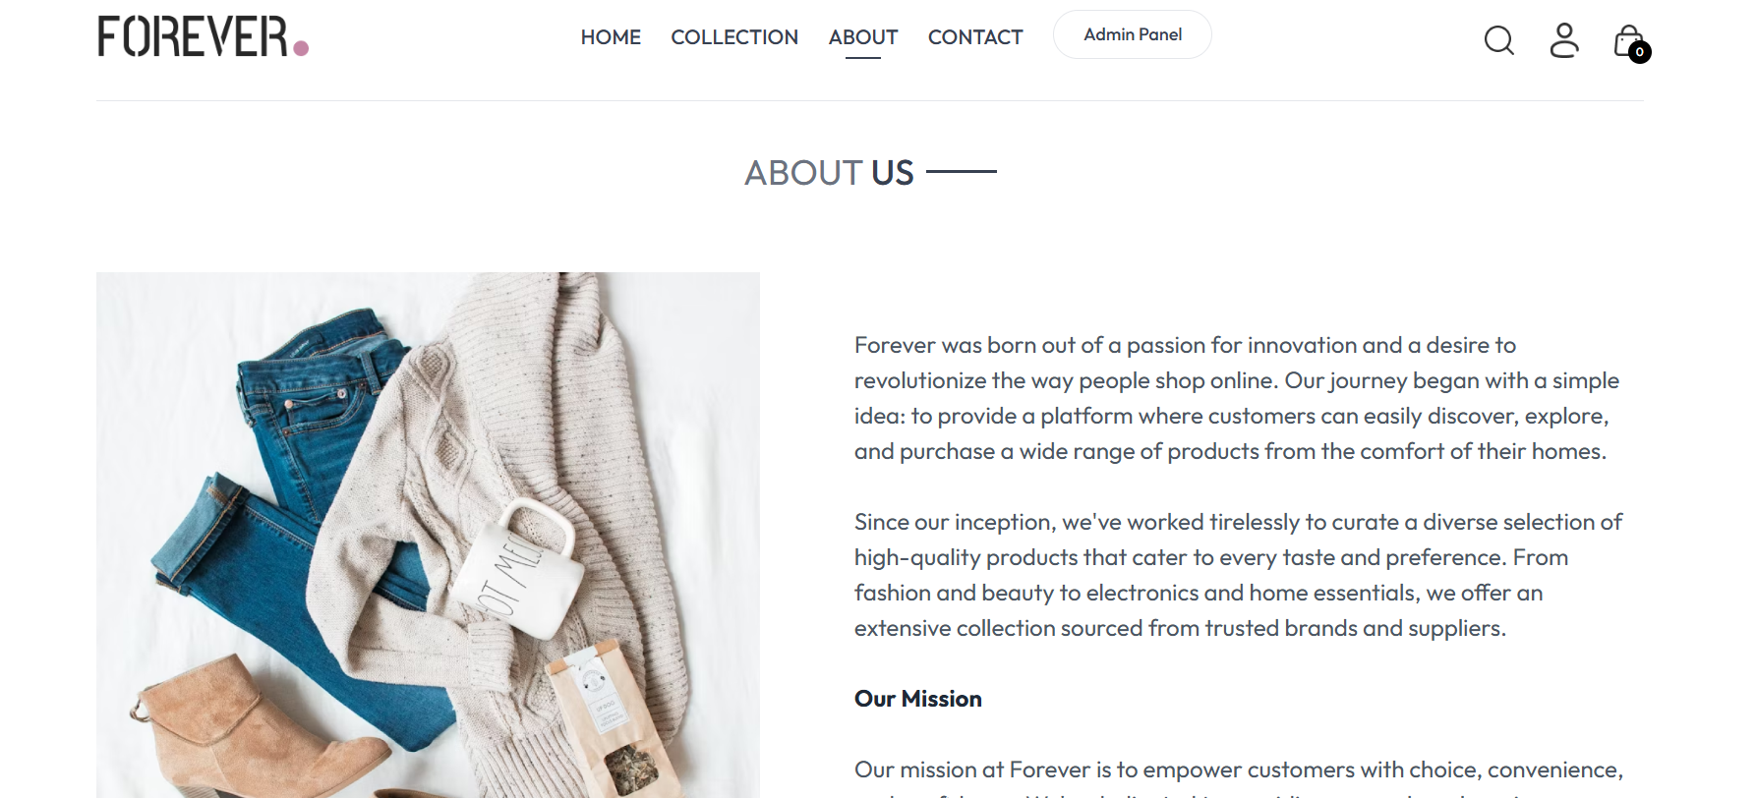
Modelling & Result
This is the result of Cart list page
after adding the product into
Add to Cart button
Here in this page user can see the
all products which has been added to Cart List and user can delete the
product which has been added to
the cart list and click on the Proceed
to checkout button to get into the
payment medthod which is last step
to place the order

Slide 12
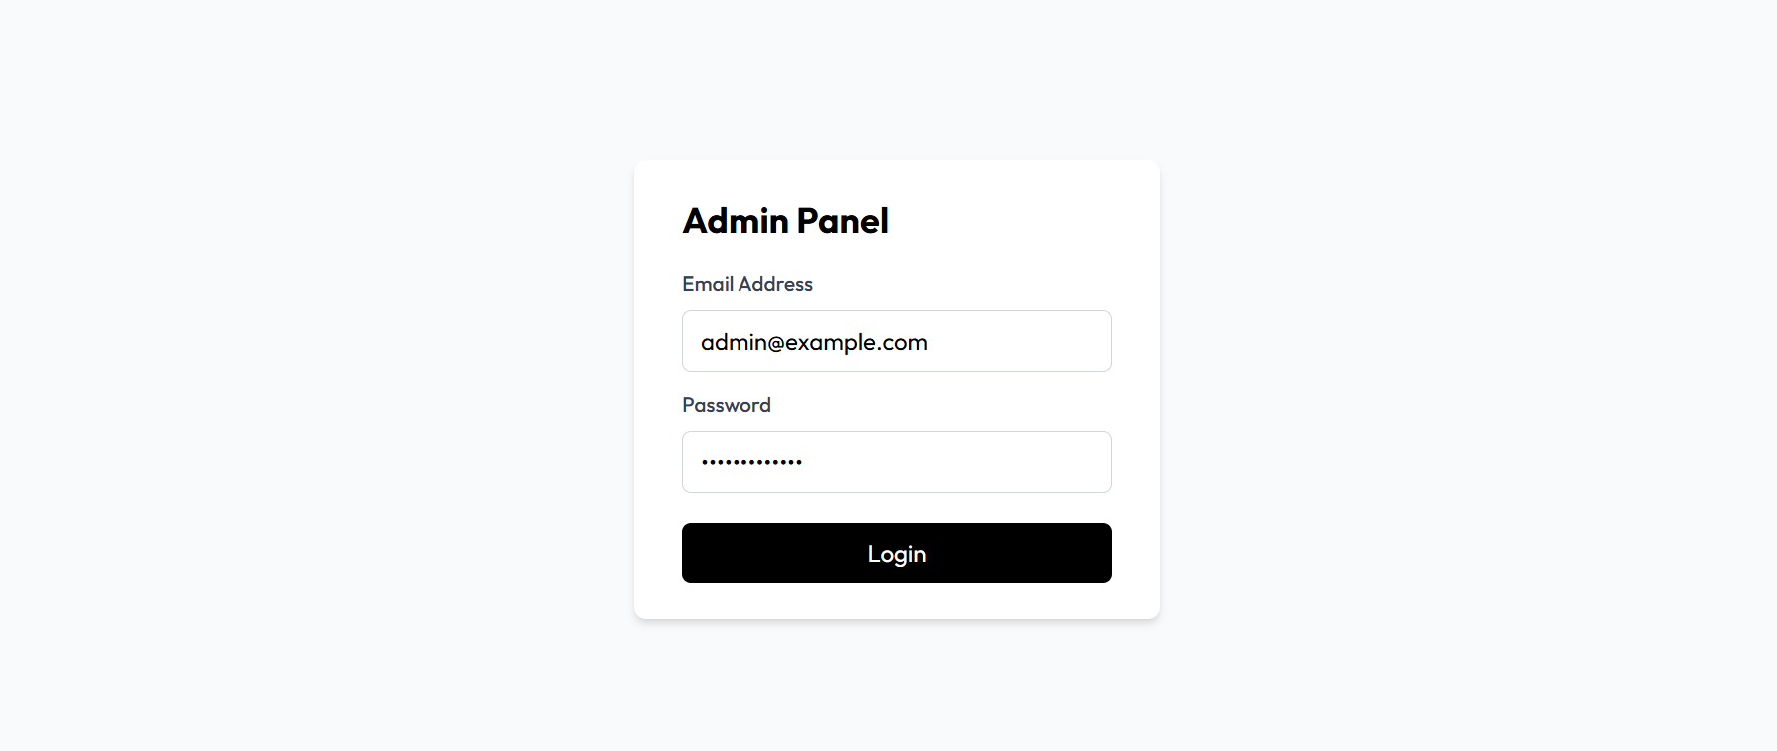
Modelling & Result
Here is the last step to place the order the user sholud enter the details
of delivery information
like name,email,address,
pincode,city,state and phone number. after filling the delivery information
select the payment mode
and click on the place
order button then your
order will be placed..!

Slide 13
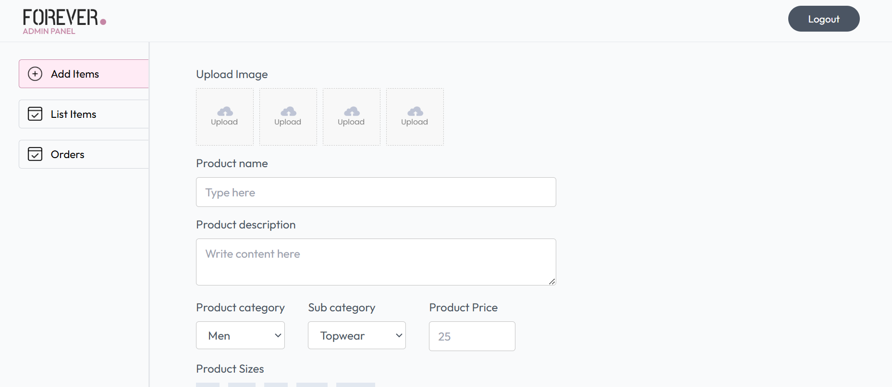
Modelling & Result
Here is the result of Admin page. In this page the Admin can Add the products to the website and remove the products from website and admin can see the total list of products are present in website and from this page admin can handle the orders placed by customer

Slide 14
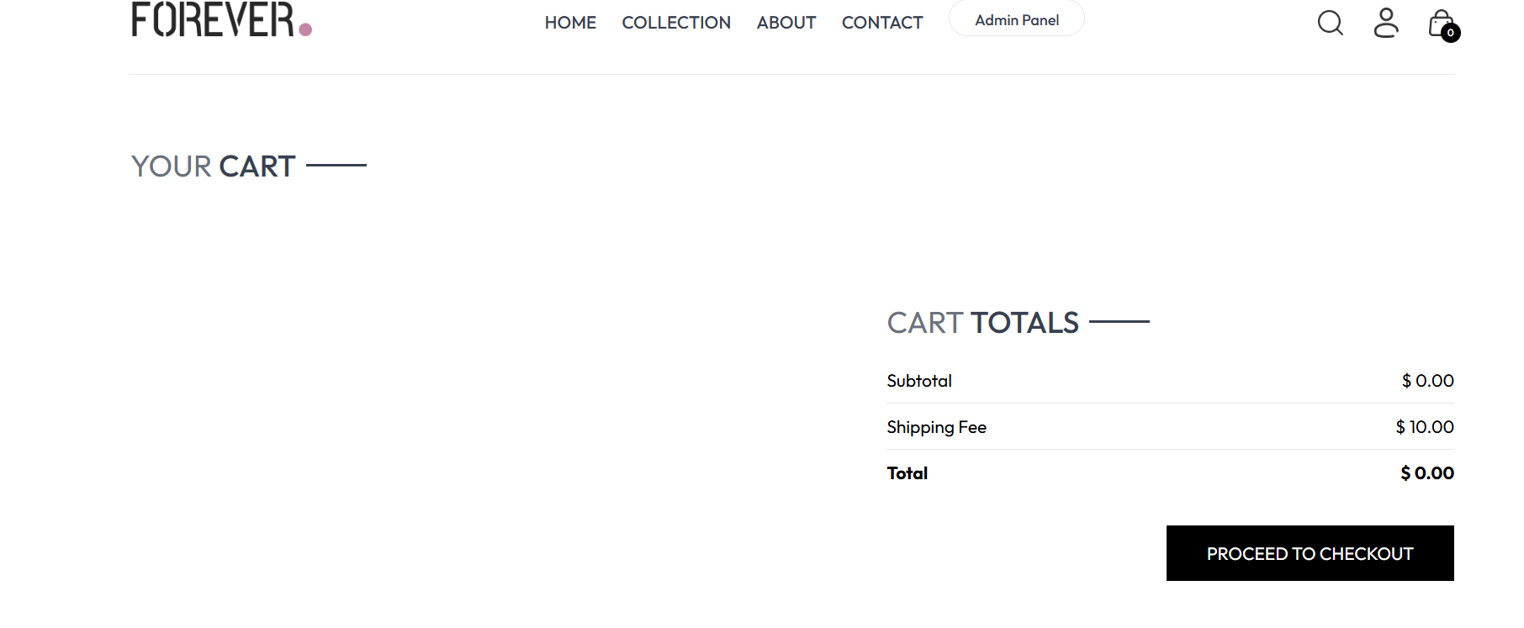
Modelling & Result
A unique, secure link generated for the payment.
Clicking on this link directs the user to the payment gateway.
Options provided for completing the payment.
Examples: Credit/Debit Card, Digital Wallets (e.g., PayPal, Google Pay), or Net Banking.
Input the email address to receive the payment receipt and order confirmation.
Ensure the website uses encryption for data security.
Enter the 16-digit card number, expiration date, and CVV (security code).

Slide 15
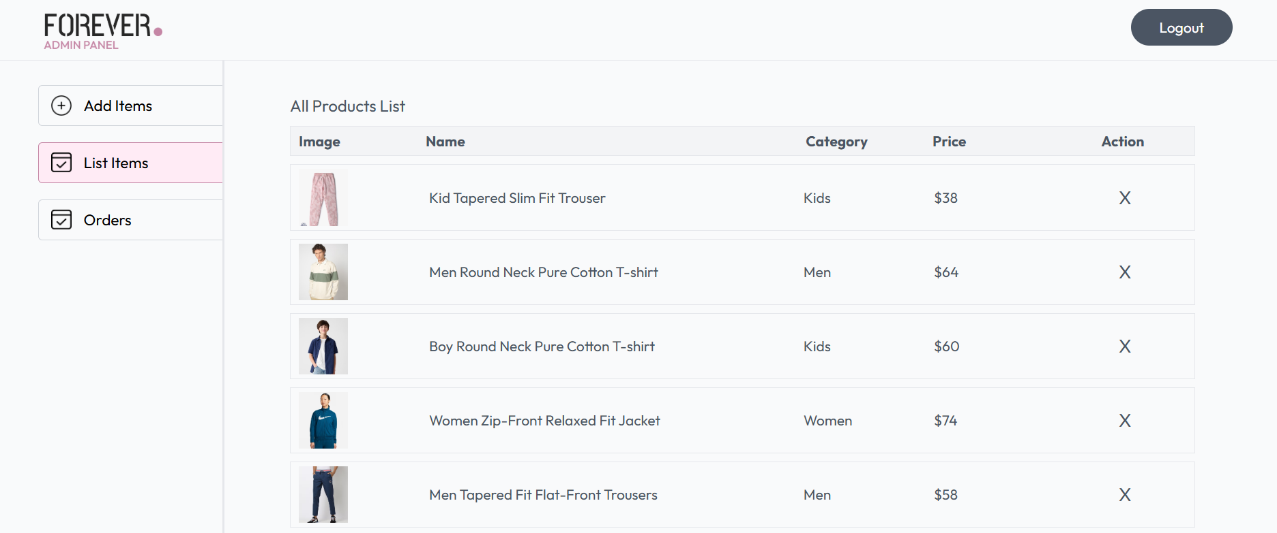
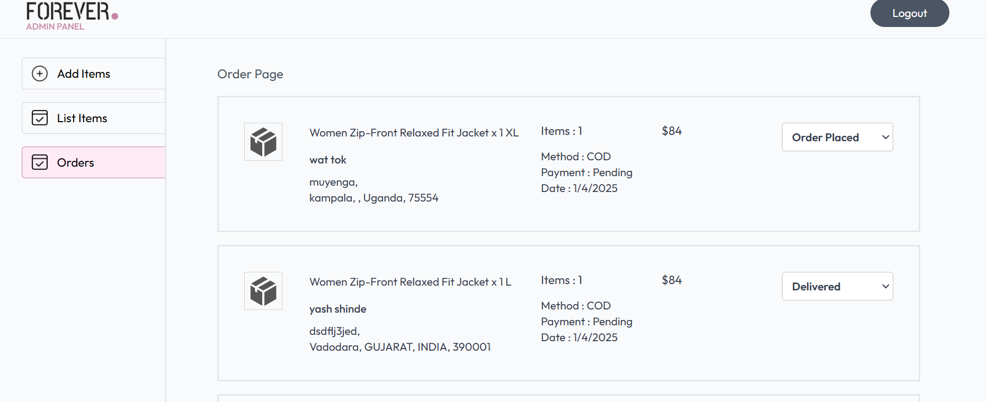
Modelling & Result
A confirmation screen displays once payment is successful, showing a receipt or order number.

Slide 16
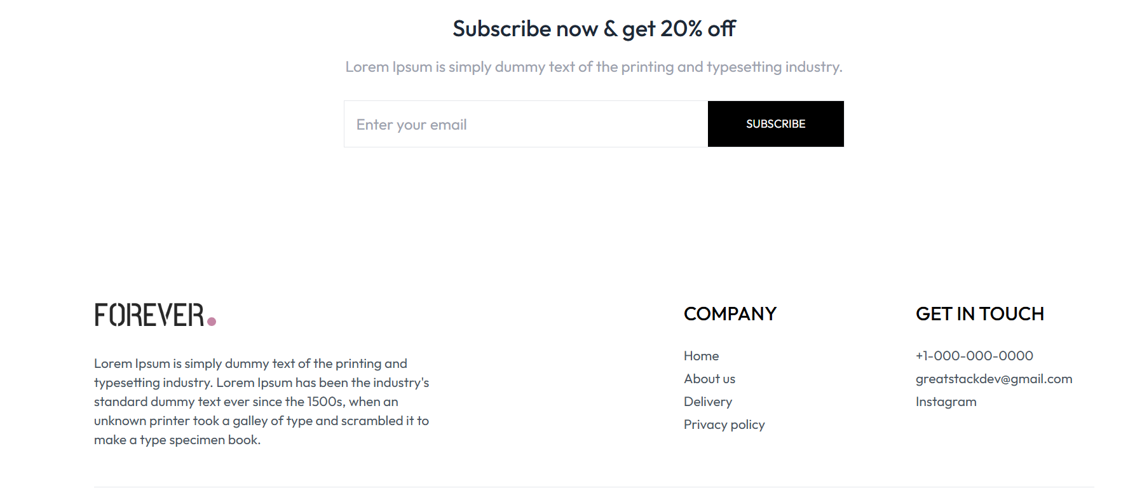
Conclusion
Clothing Store Project:
The Clothing Store website aims to revolutionize the online shopping experience by combining user-friendly design, secure payment options, and the latest fashion trends. With a focus on simplicity, convenience, and customer satisfaction, the website will offer a seamless journey from browsing to checkout. By integrating features such as diverse payment methods, regularly updated collections, and responsive design, Clothing Store will meet the needs of fashion-forward customers looking for quality, affordability, and an easy shopping experience. Ultimately, this project will create a trustworthy, engaging platform that fosters long-term customer loyalty and growth.

Slide 17


Notes:
Thank You !!

